Slide 1
CET311
Project Management
Lecture 02
Dr R L Warrender

Slide 2
Planning
The unit will cover several methods
Precedence analysis
Gantt Charts
PERT / CPA
Also …
Microsoft Project - covered in labs
Notes:
PERT / CPA
Program Evaluation and Review Technique
Critical Path Analysis

Slide 3
Planning
Contrast the difference between Production management and Project Management
Production Management is all about coordinating and controlling the activities required to make a product, typically involving effective control of scheduling, cost, performance, quality, and waste requirements
Project Management is all about the body of knowledge concerned with principles, techniques, and tools used in planning, control, monitoring, and review of projects
Taken from Business Directory at www.businessdirectory.com
Notes:
Clearly there are similarities between these two job functions. However Production Management is relates more to the repeat production of a developed product – e.g. production of a motor car. Discuss issues such as ensuring a production line never stops.
Compare this with Project Management where often as not we are looking at a project that is unique – such as the building of a new Football Stadium or the building of the new bridge.
Here we can see where sound engineering principles have to be applied to work proceeds within time schedules, within cost schedules and safe using sound engineering principles

Slide 4
Planning
Activity Planning will help to:
ensure that the appropriate resources will be available precisely when required
avoid different activities competing for the same resource at the same time
produce a detailed schedule showing which staff carry out each activity

Slide 5
Planning
Activity Planning continued:
Produce a detailed plan against which actual achievement may be measured
produce a timed forecast
re-plan the project during its life to correct drift from a target

Slide 6
Precedence analysis
Must be done before an activity plan can be produced
Reviews the activities that are to be carried out
Decides what activities must be carried out before particular activity can start
Notes:
For example you need to dig a trench in the ground before you can lay a pipe or conduit. At the same time, depending on the size of a trench, it may be a safety risk to allow a contractor to leave a trench open over too long a distance and backfilling might have to be started long before the complete trench is excavated.

Slide 7
Gantt Charts
Developed by Henry Gantt, around 1917
Gantt charts are easy to use and produce
Very useful for use on less complex projects
Notes:
Note the spelling of Gantt and do not write this as an acronym in capital letters – it was someone’s name

Slide 8
Gantt Charts
Notes:
Note that logic of the activities have to be applied
e.g. start-to-start, end-to-start, end-to-end, sometimes with lags, other times with leads, etc.

Slide 9
Gantt Charts
Draw the following Gantt chart
Tasks | Precedence | Time
a | - | 5 days
b | - | 4 days
c | a | 6 days
d | b | 2 days
e | b | 5 days
f | c, d | 8 days
(Hint:
21x7 cells)
Notes:
Try this for yourselves!

Slide 10
Gantt Charts
Draw the following Gantt chart
Tasks | Precedence | Time
a | - | 5 days
b | - | 4 days
c | a | 6 days
d | b | 2 days
e | b | 5 days
f | c, d | 8 days
(Hint:
21x7 cells)
Notes:
Note that Task f cannot start until the later of Task c or Task d

Slide 11
Network planning models
PERT
The Program Evaluation and Review Technique
CPM
Critical Path Method
Also know as CPA
Critical Path Analysis
Notes:
CPM and PERT are often used interchangeably but are technically different. We are going to primarily look at CPM (or CPA)
PERT and CPM were published in the same year – PERT being used on the development of Polaris missiles.
CPM only uses one estimate for each task duration.
PERT was developed for high-risk state-of-the-art projects and takes into consideration three duration estimates the most likely duration, the most optimistic duration and the most pessimistic duration (excluding ‘acts of God’ and warfare).

Slide 12
Network planning models
A simple activity-on-arrow network model
2
d
a
5
g
e
b
Start
1
7
End
3
h
c
f
6
4
Notes:
A project network may have only one Start Node
A project network may have only one End Node
A link (or arrow) represents an activity that takes time to execute
The length of the link is not scaled to represent the activity duration – but the overall network is drawn to represent the logic of the project

Slide 13
Terminology
Activity
Event
Network
Path
Critical

Slide 14
Terminology
On Arrow Network diagram
2
C=3
A=6
3
H=2
6
1
D=4
4
B=4
E=3
G=3
End
Start
F=10
5
Notes:
The Network is the representation of the overall logic of the project
An Activity is represented by an arrow and would normally carry a duration
An Event is the same as a node
A node is the logical division between activities
A path is the logical sequence of one activity followed by another
The critical Path is the shortest time duration between start and end events

Slide 15
Network syntax
Time moves from left to right
Nodes are numbered sequentially
A network may not contain loops
A network may not contain dangles

Slide 16
Network syntax
Precedents are the immediate preceding activities
Dummy activities can be used to indicate a particular precedence

Slide 17
Network syntax
Time moves from left to right
Nodes are numbered sequentially
a
b
1
2
3

Slide 18
Network syntax
A network may not contain loops
d
4
c
a
1
2
3
b
This is not allowed

Slide 19
Network syntax
A network may not contain dangles
a
b
1
2
3
c
4
This is not allowed

Slide 20
Network syntax
Precedents are the immediate preceding activities
Design
Build
Commission
1
2
3
4

Slide 21
Network syntax
Dummy activities can be used to indicate a particular precedence
a
c
Wrong
1
2
3
b
a
2
1
Right
b
c
3
4

Slide 22
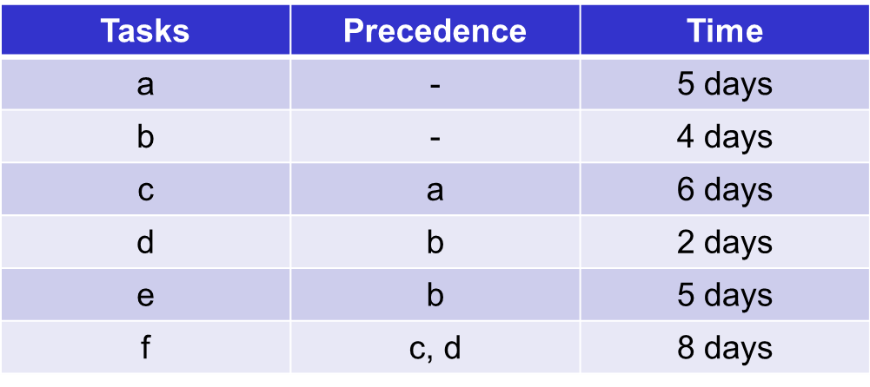
On Arrow Networks
Draw the following as an on arrow network
Notes:
Try this for yourselves!

Slide 23
On Arrow Networks
How to start …
a
2
start
1
b
3

Slide 24
On Arrow Networks
What not to do
c
a
2
4
start
1
b
d
5
3
e
6

Slide 25
On Arrow Networks
A better way ……
c
a
2
start
1
b
d
3
e

Slide 26
On Arrow Networks
It is then less confusing that c & d go to the same event … but what about e & f ?
c
f
a
2
4
6
start
1
b
d
e
3
5

Slide 27
On Arrow Networks
The completed on arrow network …
c
a
2
4
f
start
1
b
d
5
end
e
3

Slide 28
On Arrow Networks
Another on arrow network to draw
Tasks | Precedence | Time
a | - | 6 weeks
b | - | 4 weeks
c | a | 3 weeks
d | b | 4 weeks
e | b | 3 weeks
f | - | 10 weeks
g | e, f | 3 weeks
h | c, d | 2 weeks
Notes:
Try this for yourselves!

Slide 29
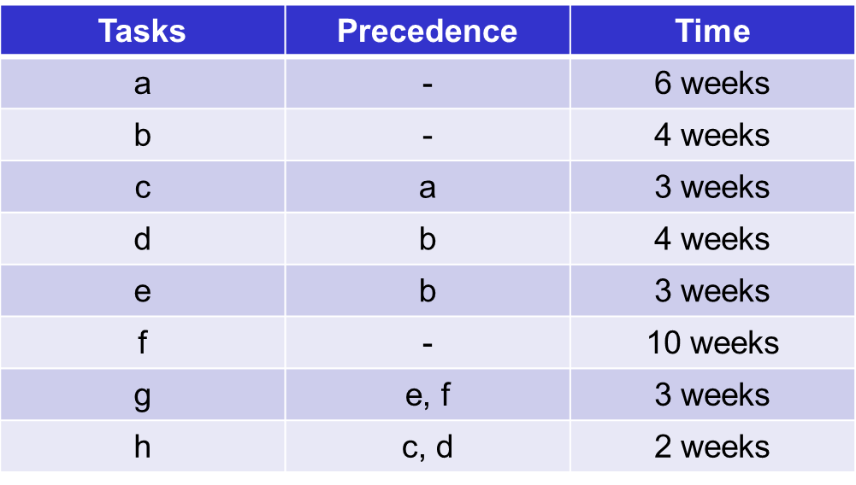
On Arrow Networks
The network with activity times added
2
C=3
A=6
B=4
D=4
H=2
1
3
4
6
E=3
G=3
F=10
5

Slide 30
On Arrow Networks
Each event circle can contain the information below
Event
number
Earliest
date
Latest
date
Slack
Event

Slide 31
Event numbers
2
3
6
1
4
5

Slide 32
Timed activities
2
C=3
A=6
3
H=2
6
1
D=4
4
B=4
E=3
G=3
F=10
5

Slide 33
Forward pass
2
6
C=3
A=6
3
H=2
6
1
D=4
4
B=4
4
13
0
9
E=3
G=3
F=10
5
10
Notes:
In the forward pass, we take the latest duration to arrive at the event (or node) – this is the earliest date when this event can be completed.

Slide 34
Backward pass
2
6
8
C=3
A=6
3
H=2
6
1
D=4
4
B=4
4
13
13
0
0
7
9
11
E=3
G=3
F=10
5
10
10
Notes:
In the backward pass, we take the earliest duration to arrive at the event (or node) – this is the latest date when this event must be completed.

Slide 35
Event, Slack and Activity Float
2
6
8
2
C=3
A=6
3
H=2
6
1
D=4
4
B=4
4
13
13
0
0
7
9
11
0
0
3
2
E=3
G=3
F=10
5
10
10
0
Notes:
Slack is then defined as the difference between the earliest date and the latest date for each event (or node)

Slide 36
The Complete On Arrow Network
2
6
8
2
C=3
A=6
3
H=2
6
1
D=4
4
B=4
4
13
13
0
0
7
9
11
0
0
3
2
E=3
G=3
F=10
5
10
10
0
Notes:
The critical path is then highlighted (traditionally in Red or / and dotted lines) between the start and the end.

Slide 37
On Arrow Networks
Draw the following as an on arrow network with figures included
Tasks | Precedence | Time
a | - | 5 days
b | - | 4 days
c | a | 6 days
d | b | 2 days
e | b | 5 days
f | c, d | 8 days
Notes:
Try this for yourselves!

Slide 38
Next steps
Next week - Precedence Networks

